Slide 1
Task 1: SOLVING THE VULNERABILITIES OF XSS LABS AT P0RTSWIGGER
Steps for performing task 1 :
STEP 1: Open VIRTUAL BOX and login to KALI LINUX.
STEP 2: Open Firefox in LINUX and search PortSwigger.
STEP 3: Sign up to PortSwigger by making an account.
STEP 4: After signing up sign in to the website.
STEP 5: Click on the Academy on the top right of the website.
STEP 6: Click on All Labs option.
STEP 7: Different SQL injection ,Cross site scripting ,Cross site request forgery ,clickjacking , etc. labs with different levels appear on the website.
STEP 8: Start solving the vulnerabilities of xss labs by using payloads.
STEP 9: Payloads can be downloaded from github.
STEP 10: Screenshots of any 5 vulnerabilities completed by me have been attached to this presentation.

Slide 2
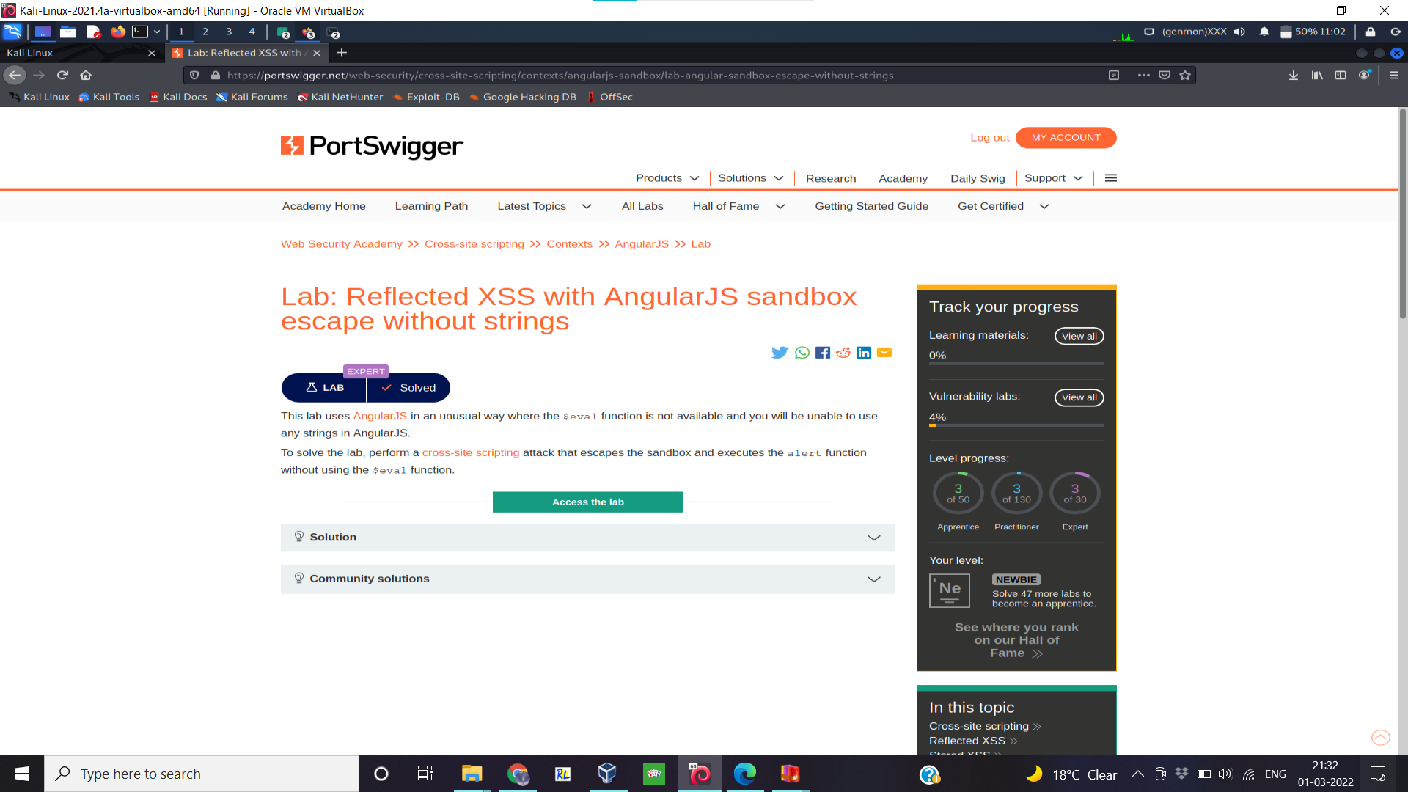

Slide 3
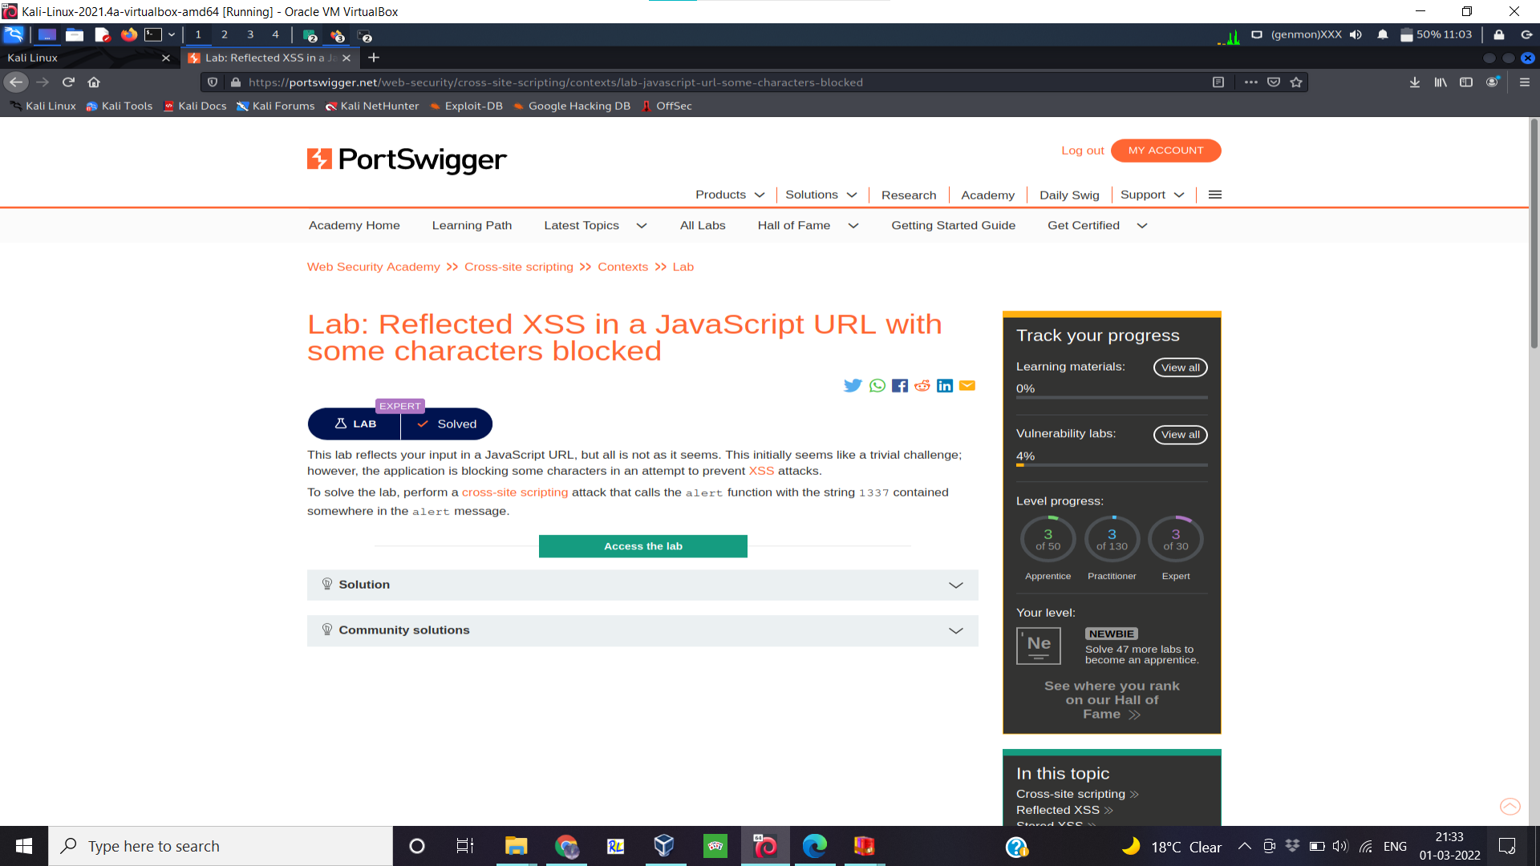

Slide 4
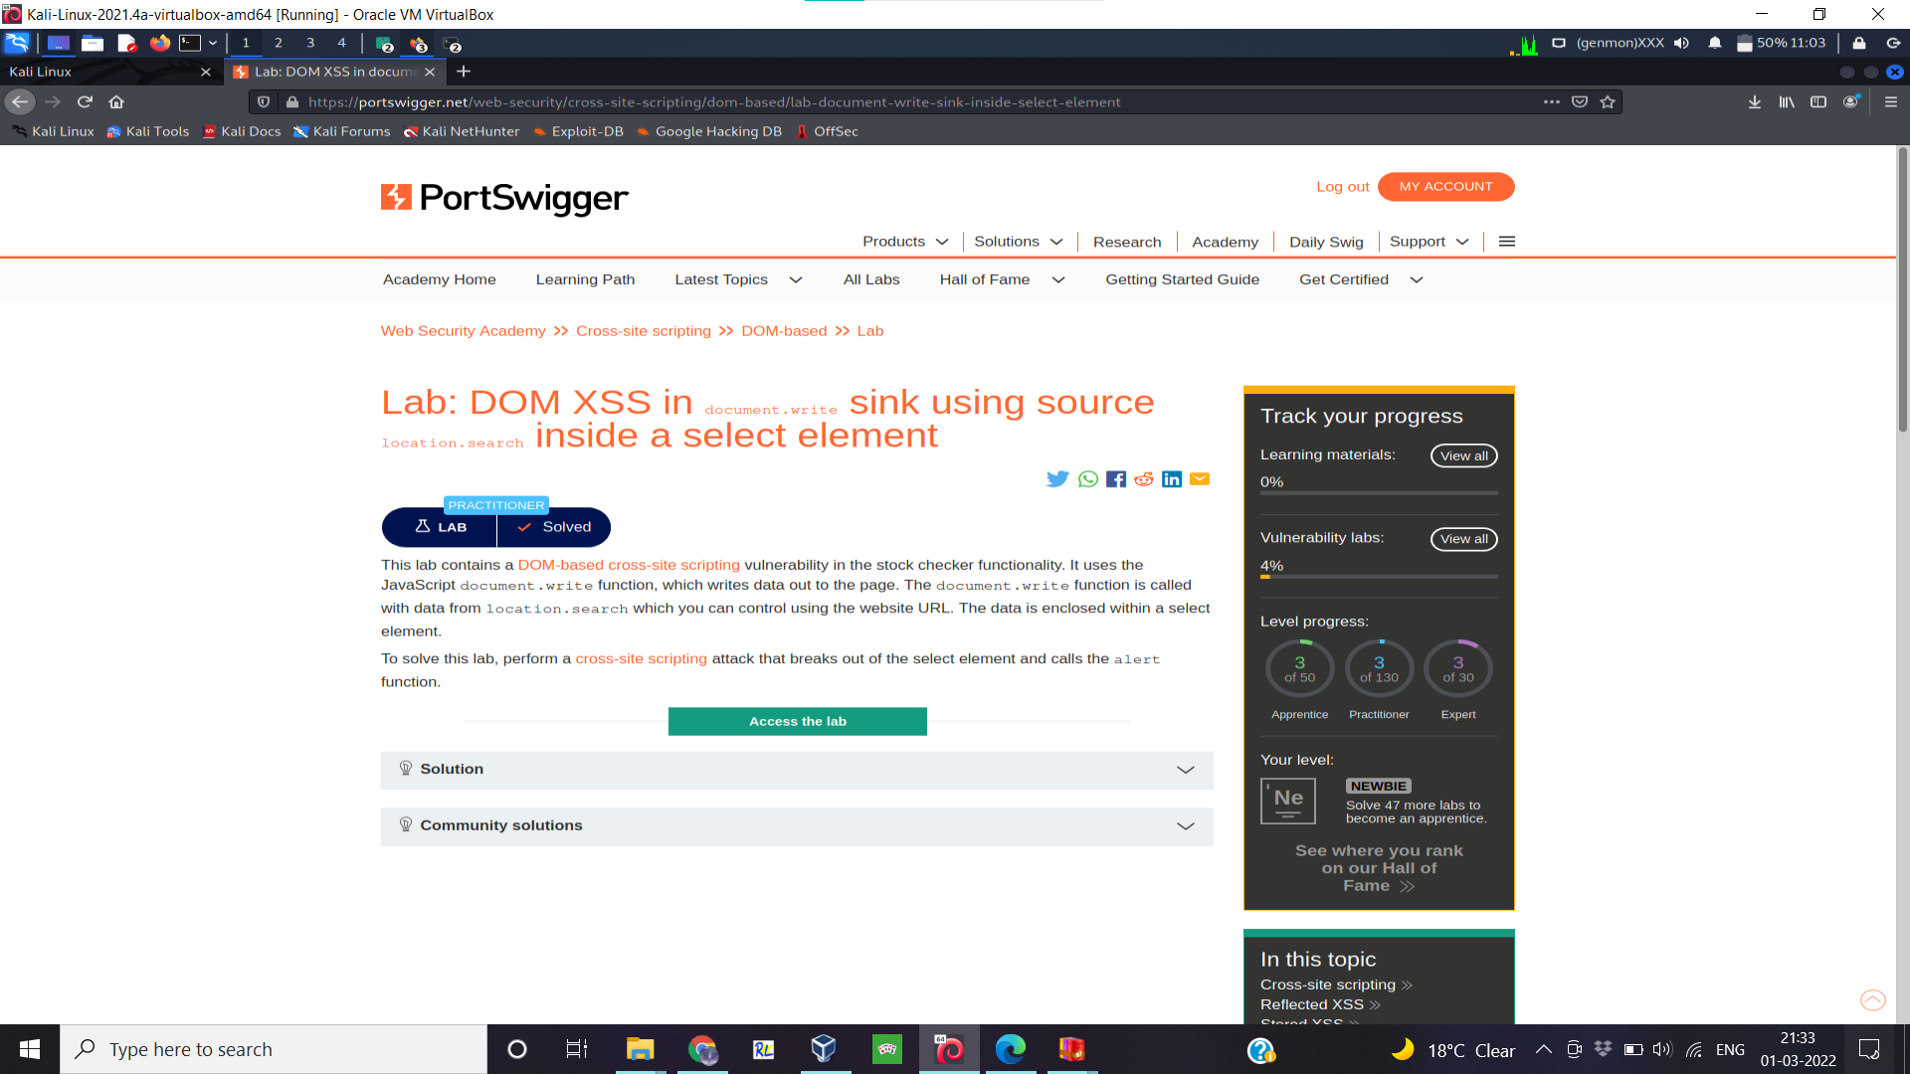

Slide 5
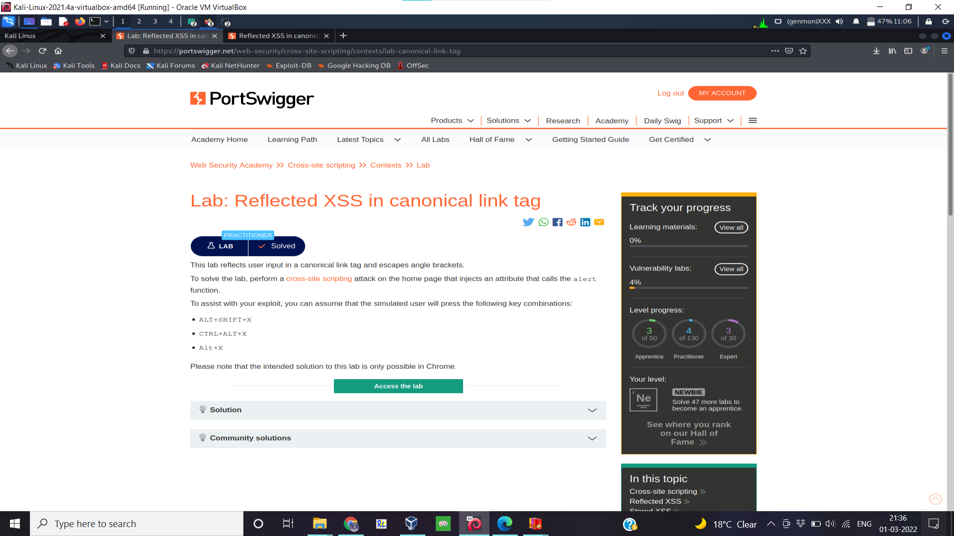

Slide 6
